Slide 1
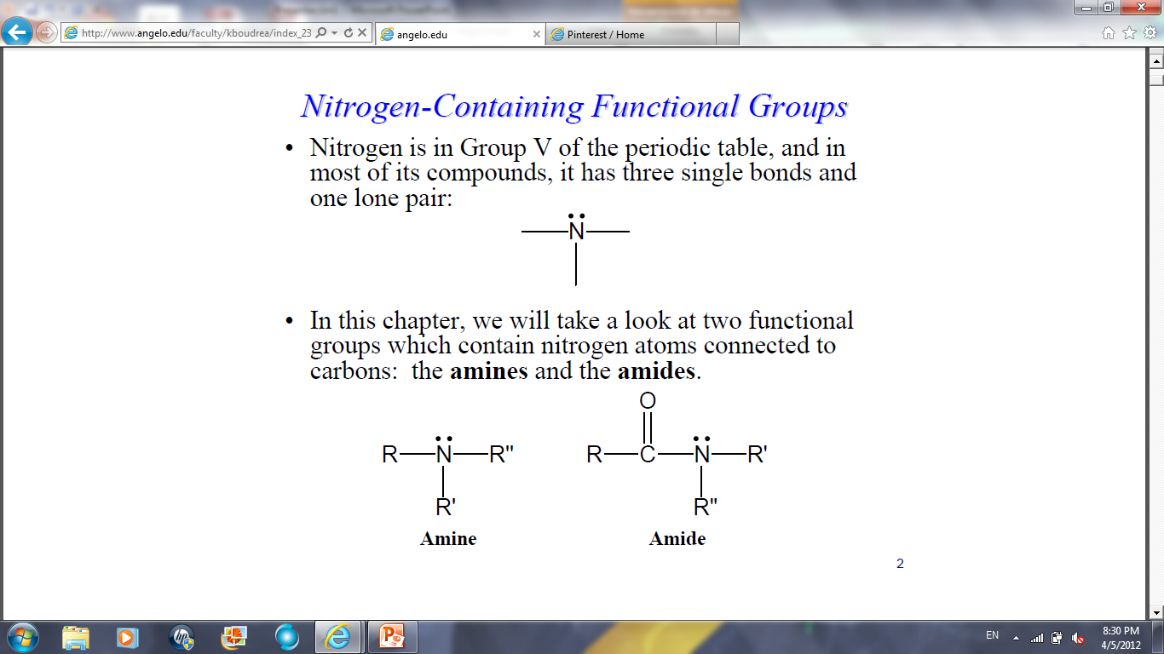
Amines and amides
They are nitrogen containing functional groups
Nitrogen has three single bonds and one lone pair
Amines and amides contain nitrogen atoms connected to carbons.

Slide 2

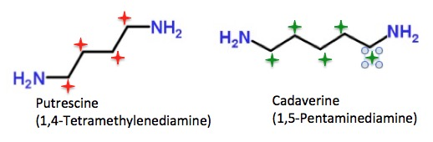
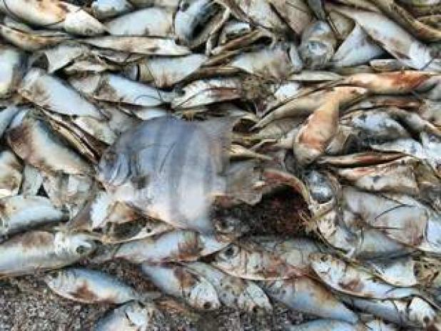
Amines
Amines are basic compounds with strong odors.
The odor of amines is often described as "fishy" since the odor of raw fish comes from the amines contained.
Substance produced in decaying flesh: cadaverine and putrescine.
Amines are essential to life as constituents of amino acids.

Slide 3

Amines: where can we find them?
They occur in drugs and vitamins
Essential starting materials for many synthetic processes.
Aniline (aromatic amine) is the basis for a whole class of synthetic dyes.
Synthetic amines such as benzedrine have medical applications.

Slide 4
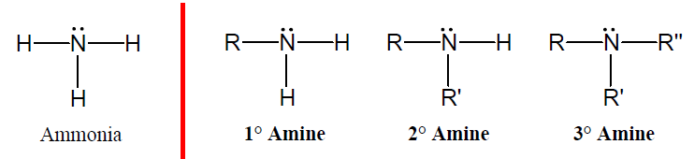
Amines
Amines are organic derivatives of ammonia, NH₃, in which one or more of the three H’s is replaced by a carbon group.
Can be classified as primary, secondary and tertiary depending on how many carbon groups are connected to the nitrogen atoms.

Slide 5
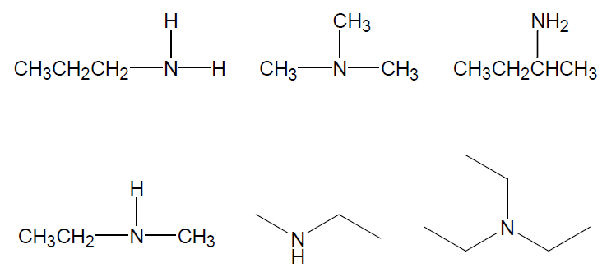
Classify the following amines:

Slide 6
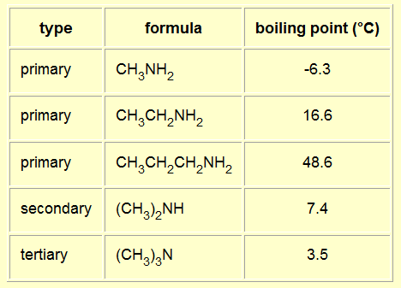
Physical properties of amines:
Look at the boiling points and figure out why are they so different.

Slide 7
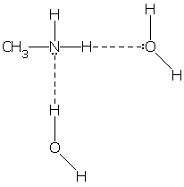
Solubility of amines
The small amines of all types are very soluble in water.
All the amines can form hydrogen bonds with water - even the tertiary ones.
Tertiary amines can still form hydrogen bonds with water.
Solubility falls off as the hydrocarbon chains get longer - noticeably so after about 6 carbons.

Slide 8
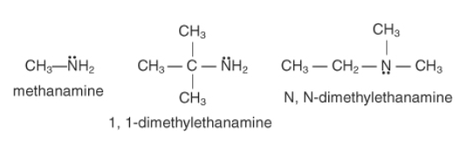
Amine nomenclature (IUPAC)
Pick out the longest continuous carbon chain. The parent's name comes from the alkane.
Change the –e of the alkane to amine.
Locate and name the substituents, the #1 carbon is the one attached to the amino group.
Substituents attached to the nitrogen atom, are designated with an N.

Slide 9
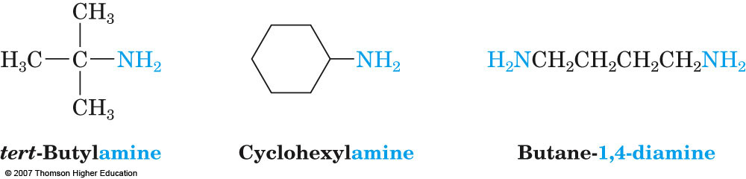
Nomenclature
Primary amines are named in the IUPAC system by adding the suffix amine to the name of the organic substituent

Slide 10
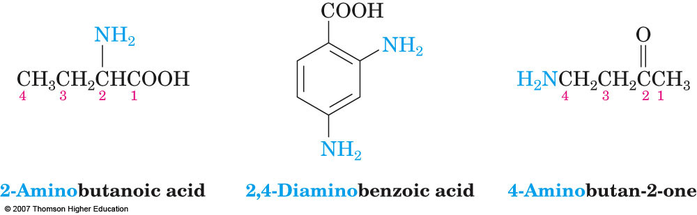
Nomenclature
Priorities:
Carboxylic acids
Aldehydes
Ketones
Alcohols
NH2, NHR, NR2
Alkyl, aryl, halo
Amines that have additional functional groups are named by considering the –NH2 as an amino substituent on the parent molecule

Slide 11
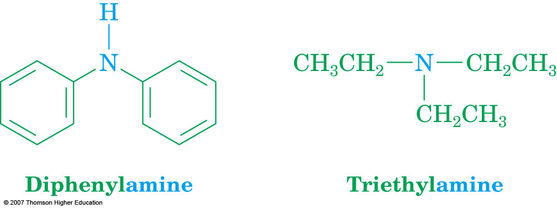
Nomenclature
Symmetrical secondary and tertiary amines are named by adding the prefix di-or-tri to the alkyl group

Slide 12
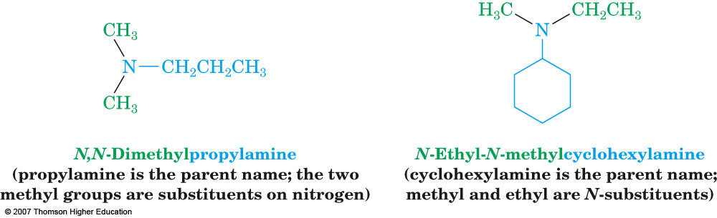
Nomenclature
Unsymmetrically substituted secondary and tertiary amines are named as N-substituted primary amines

Slide 13
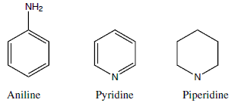
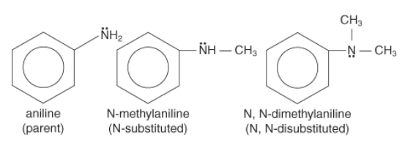
Aromatic amines nomenclature
Aromatic amines belong to specific families, which act as parent molecules:
Example: aniline

Slide 14
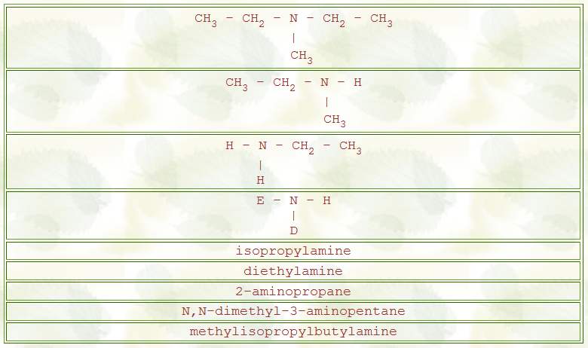
Let’s practice:

Slide 15
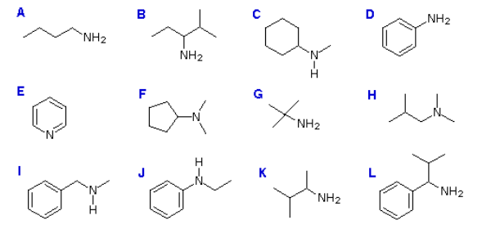
Let’s practice some more:

